Slide 1
Let’s Do A Thing and Call it Foo

Slide 2
The terms foobar (/ˈfuːbɑːr/), foo, bar, baz, and others are used as metasyntactic variables and placeholder names in computer programming or computer-related documentation.^{[1]} They have been used to name entities such as variables, functions, and commands whose exact identity is unimportant and serve only to demonstrate a concept.
https://en.wikipedia.org/wiki/Foobar

Slide 3
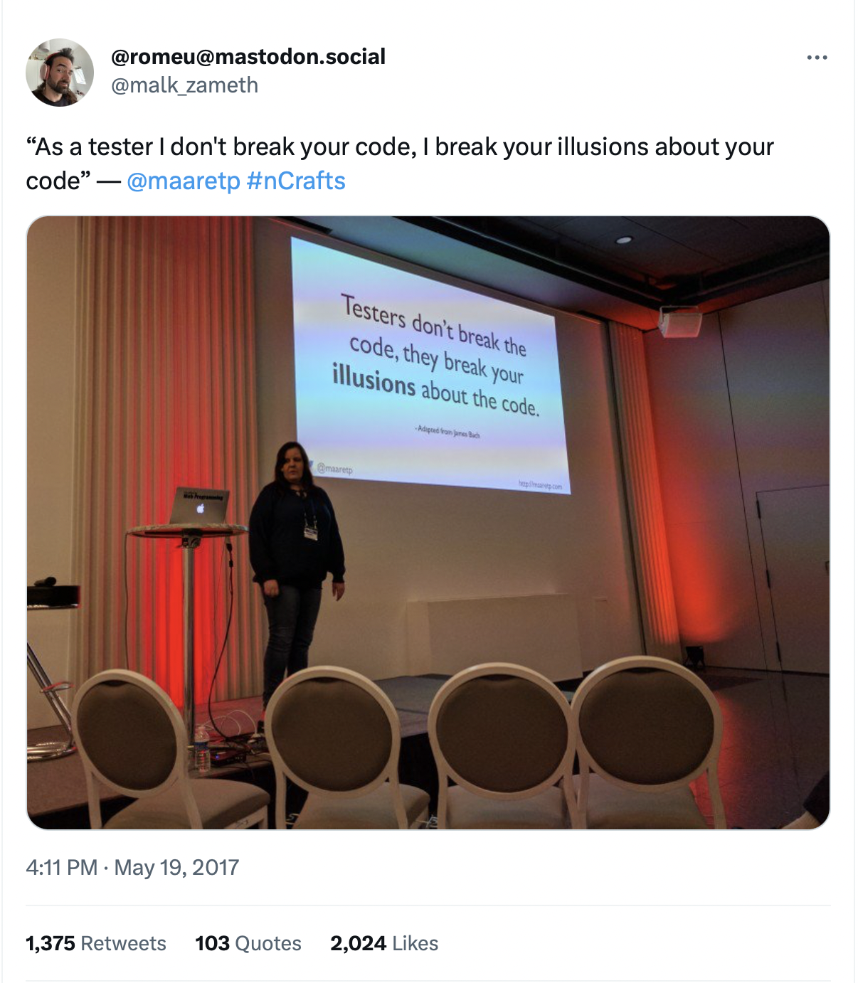
TESTING not TESTERS.
Developers are brilliant explorers.
Testing is too important to be left for testers. Testing is too important to be left without testers.

Slide 4
”Find (some of) What Others May Have Missed”
Stakeholders happy, even delighted
–Quality Information
Surprise!
Results Gap
Good Team’s Output
–Quality Information
Results Gap on a Team that thinks
Testers == Testing
Pick up the pizza boxes…
Less than Good Team’s Output
–Quality Information

Slide 5
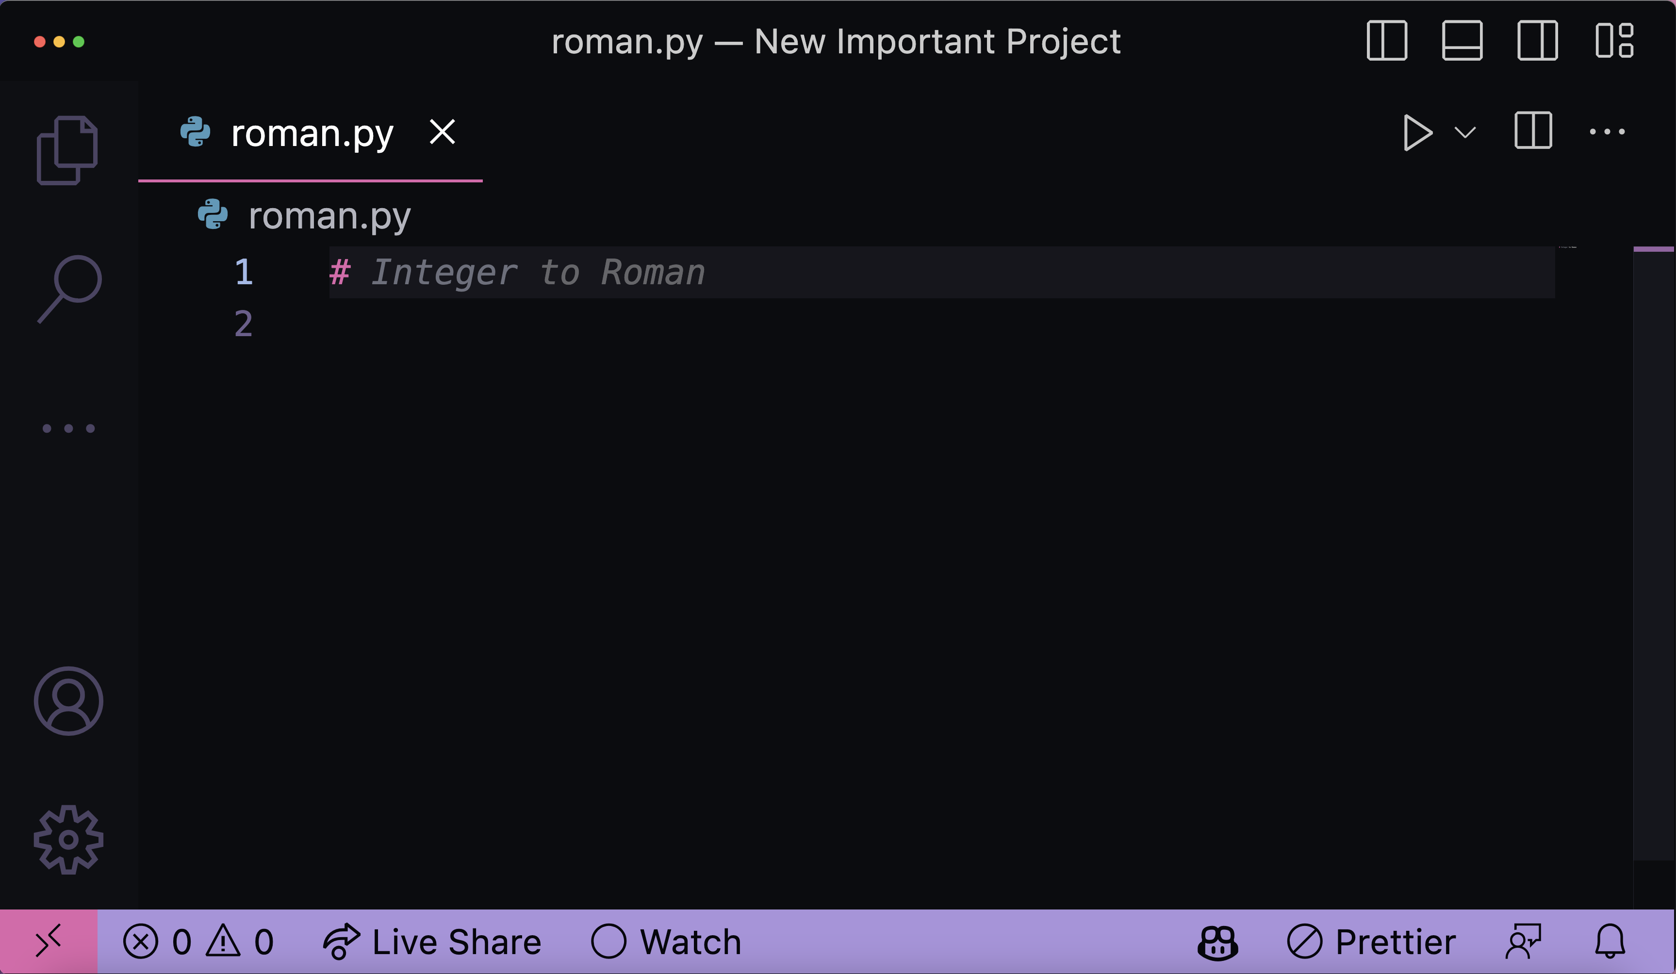
Guessing with power to accept
For Mood: https://aboutmonica.com/blog/how-to-make-your-vs-code-sparkle/

Slide 6
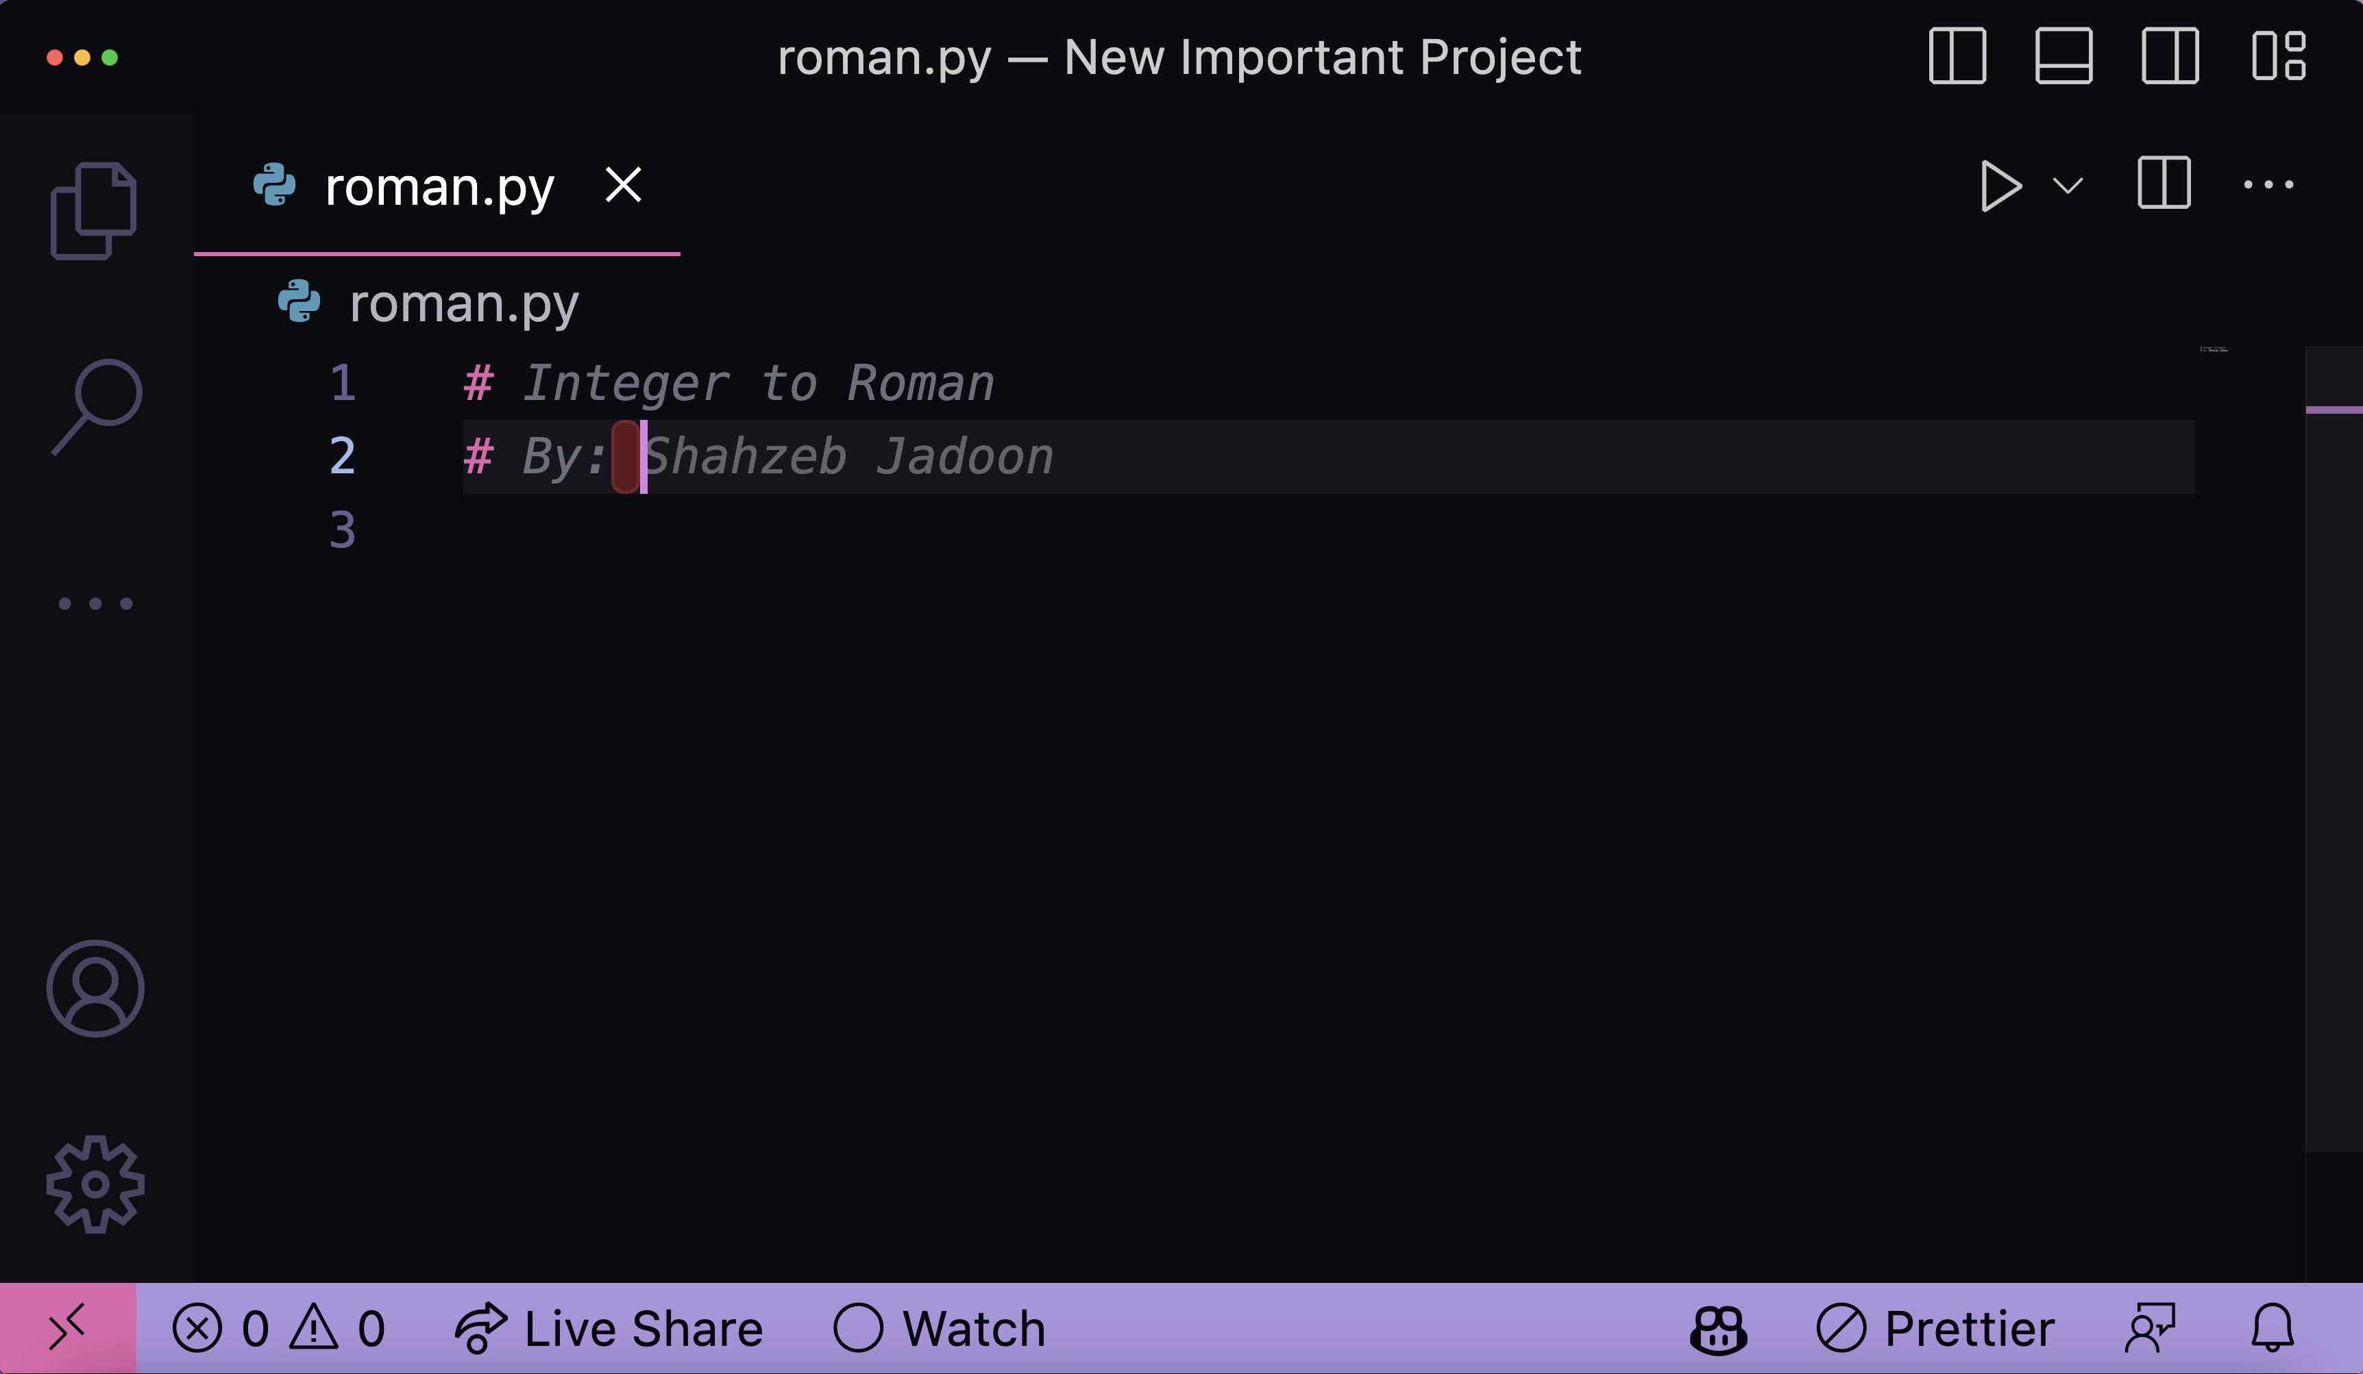
Guessing with power to accept
Who Am I?
Fooing my program or the tool?

Slide 7
Note:
…pillaging digital content without consent, compensation and attribution
Even if legal not ethical.

Slide 8
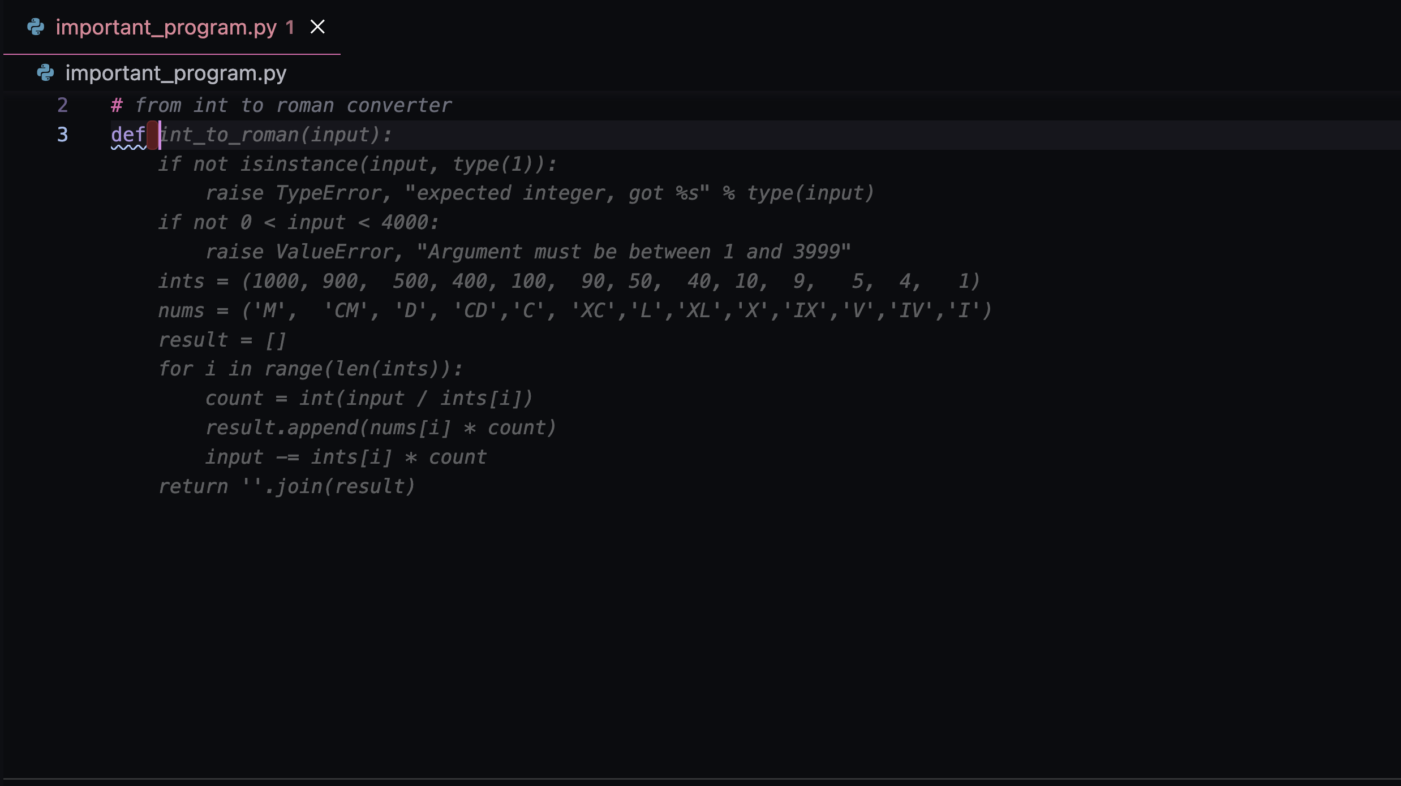

Computer Assisted Software Authorship
https://github.com/features/copilot/

Slide 9
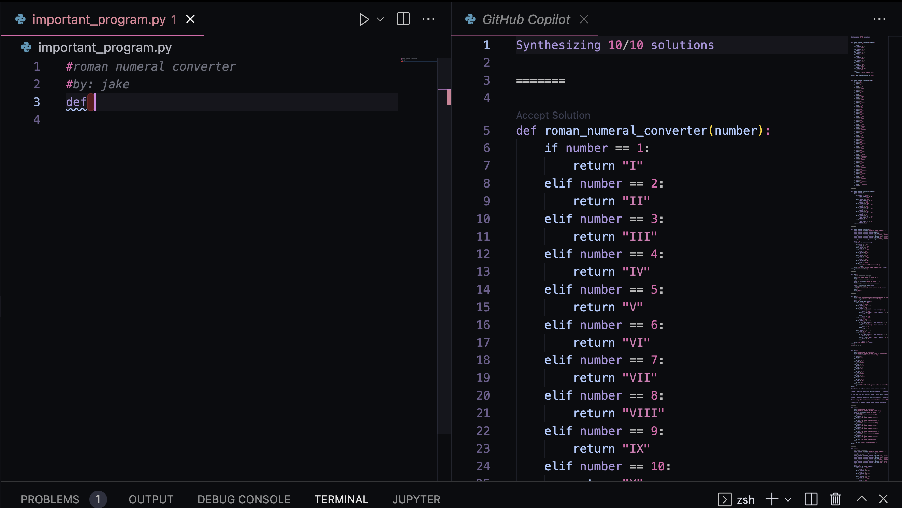
CTRL+enter for alternatives

Slide 10
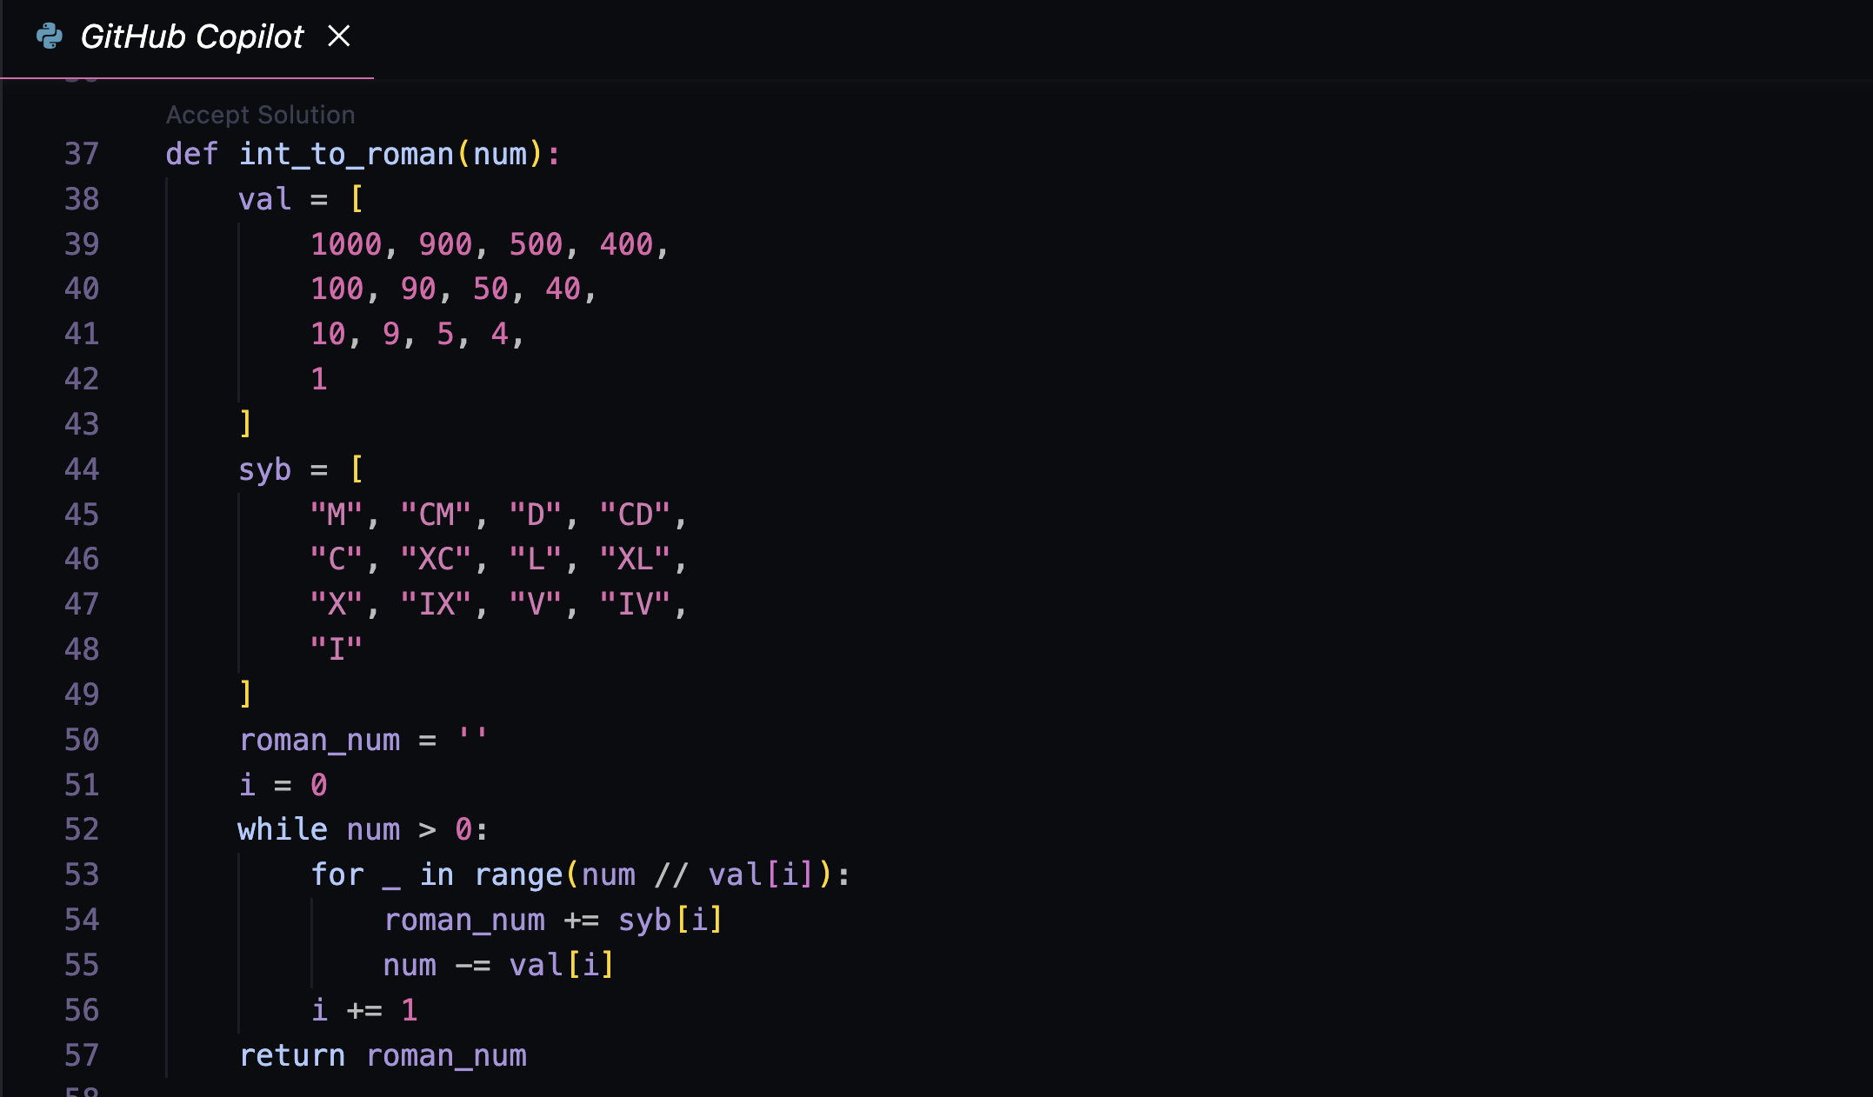
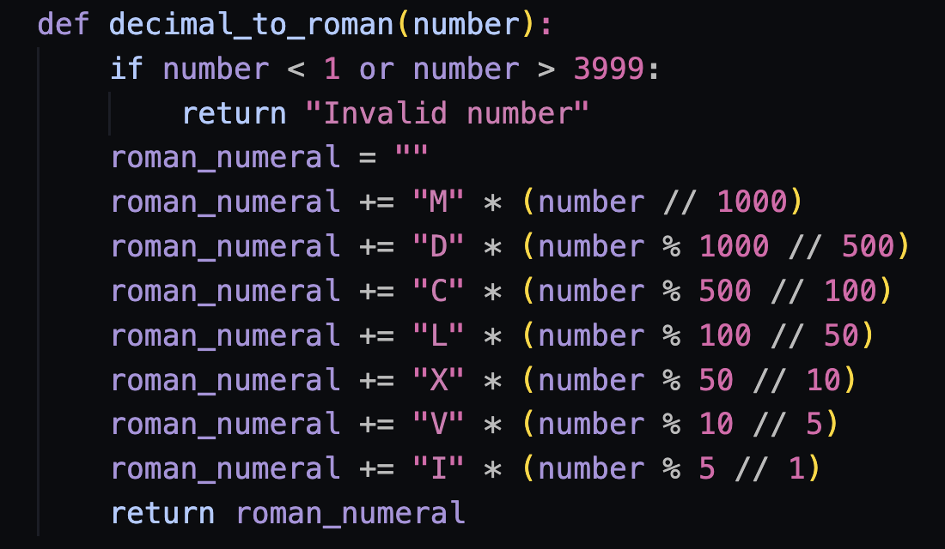
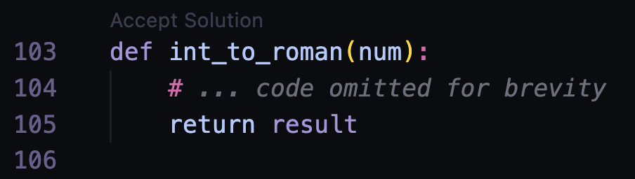
CTRL+enter for alternatives

Slide 11
1. Intent / Implementation
2. Domain for the Layman
3. Domain for the Expert
4. Reference Implementation
5. People Filtering
WE are
accountable

Slide 12
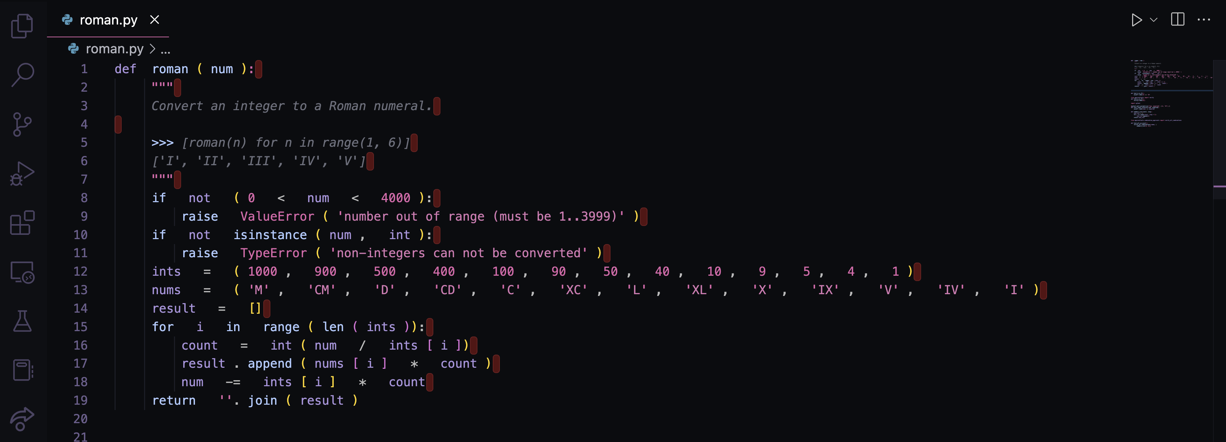
Say We Have This…
Done?

Slide 13
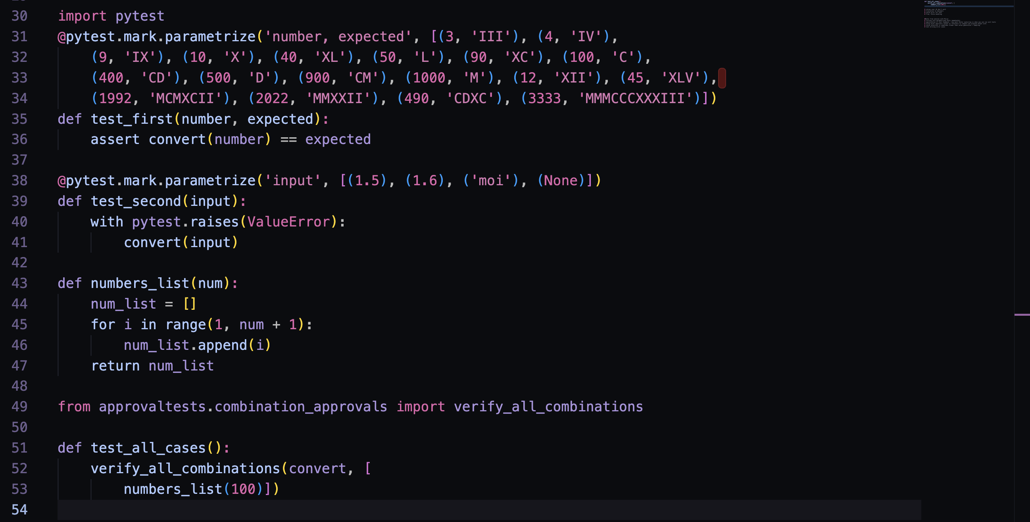
Some Tests
Done?

Slide 14
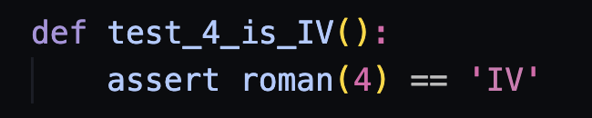
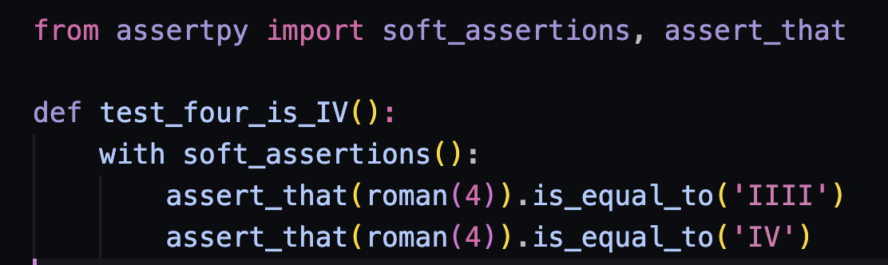
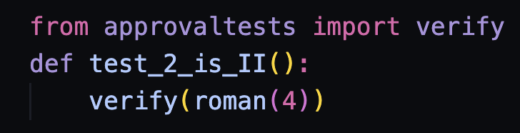
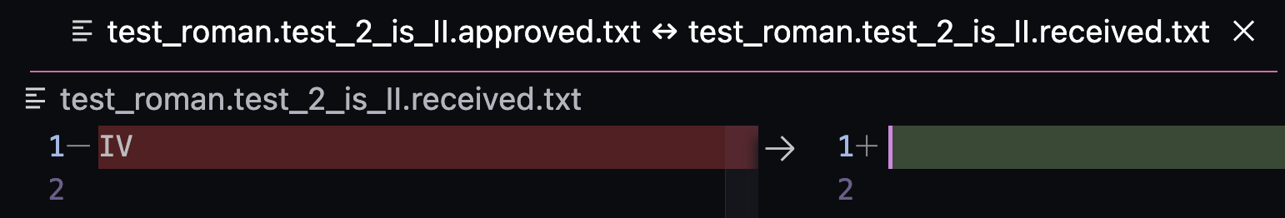
Shapes of Approaches
Asserts
Approvals

Slide 15
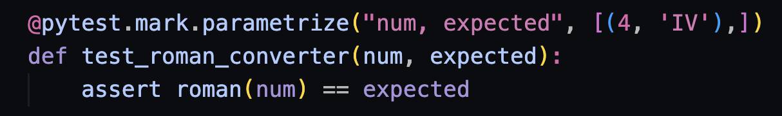
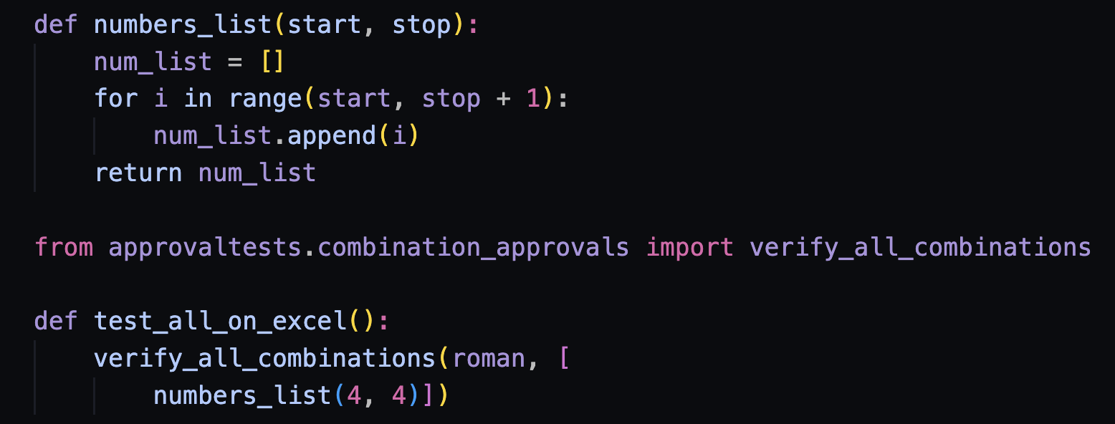
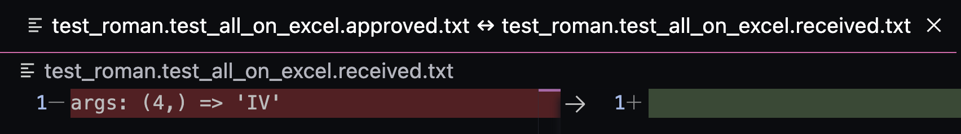
From One to Many
Asserts
Approvals

Slide 16
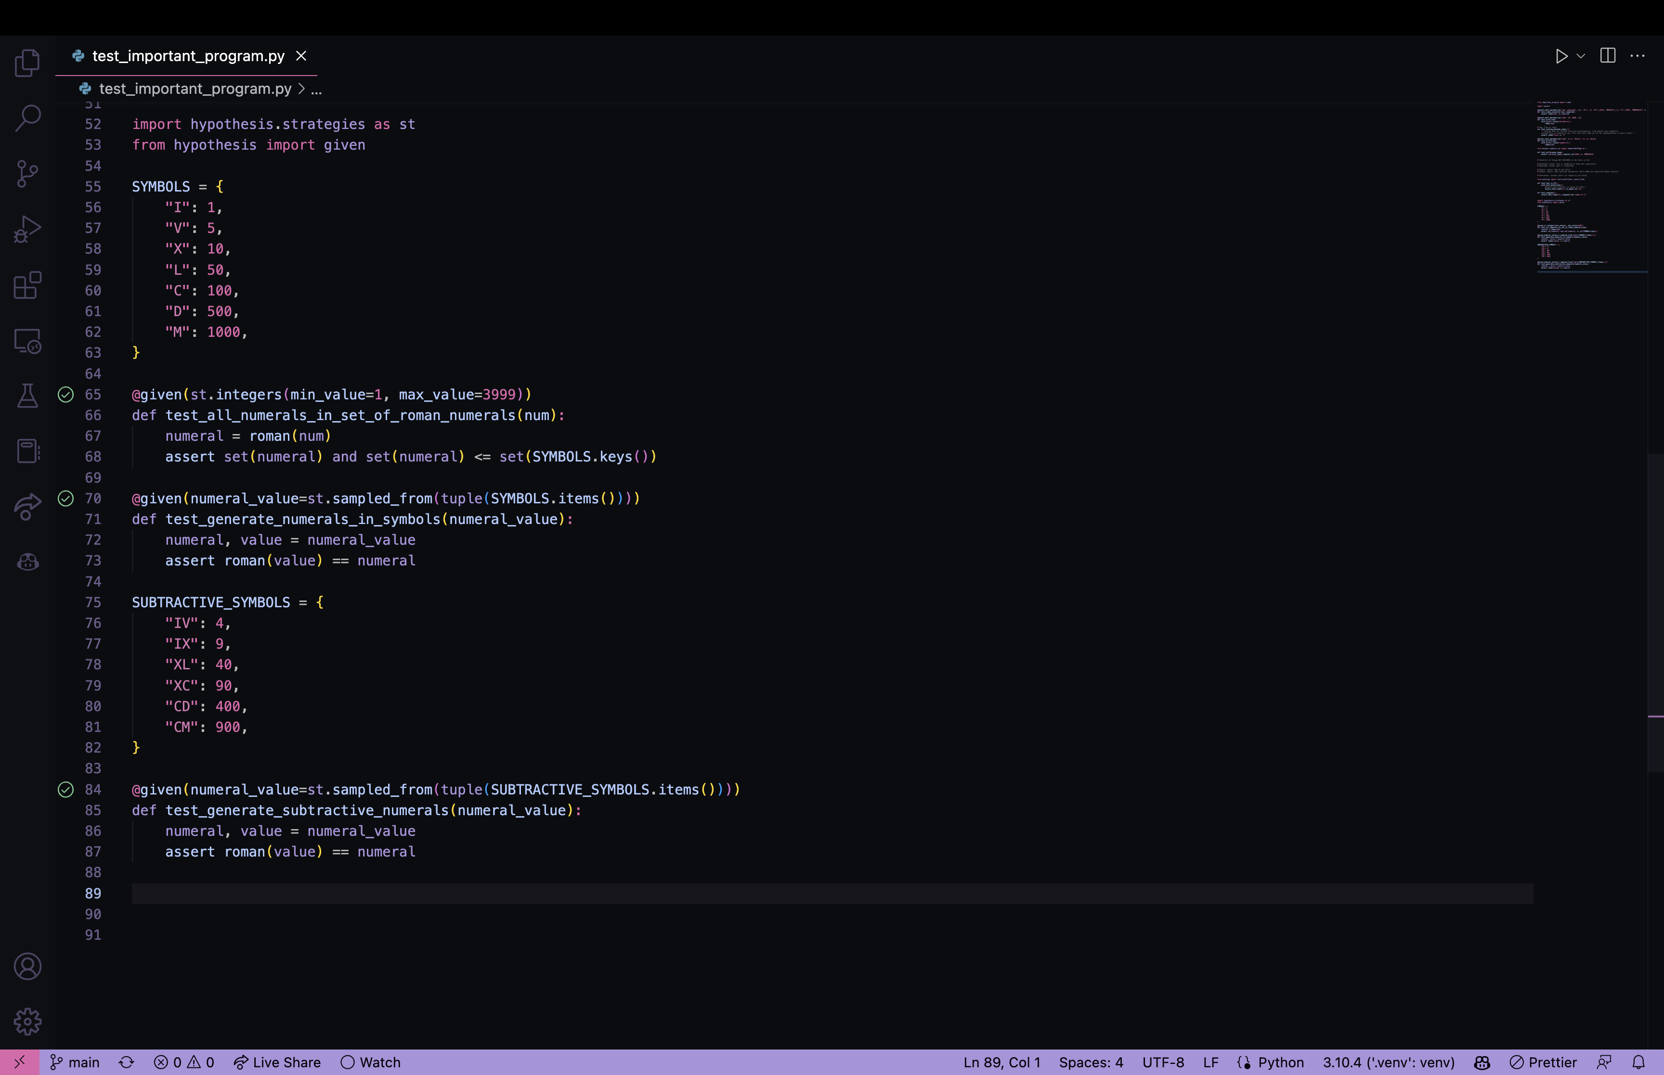
Hypothesis

Slide 17
Note:
…developer intent. It might not do what you wanted it to do.

Slide 18
Developer intent
Part 1. Review for correctness and conciseness
Part II. Input -> Output
Part III. Rules of behavior boundaries
Part IIII. Coverage
Part IIIII. Sampling vs wide nets (approvals)
Part VI. Properties

Slide 19
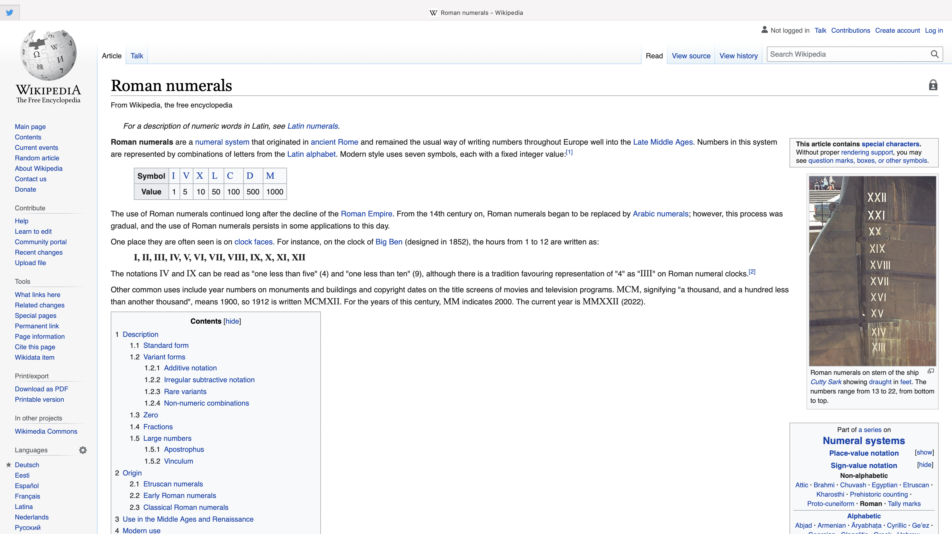
https://en.wikipedia.org/wiki/Roman_numerals

Slide 20
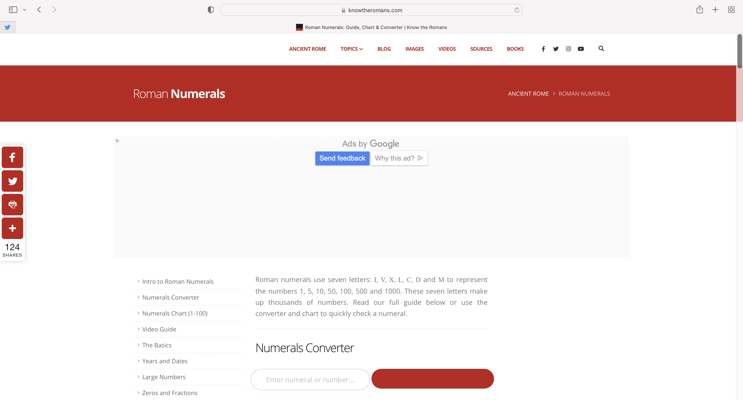

Slide 21

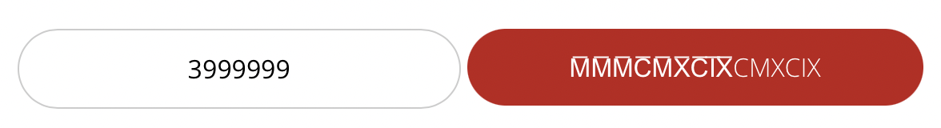
Upper Boundary?

Slide 22
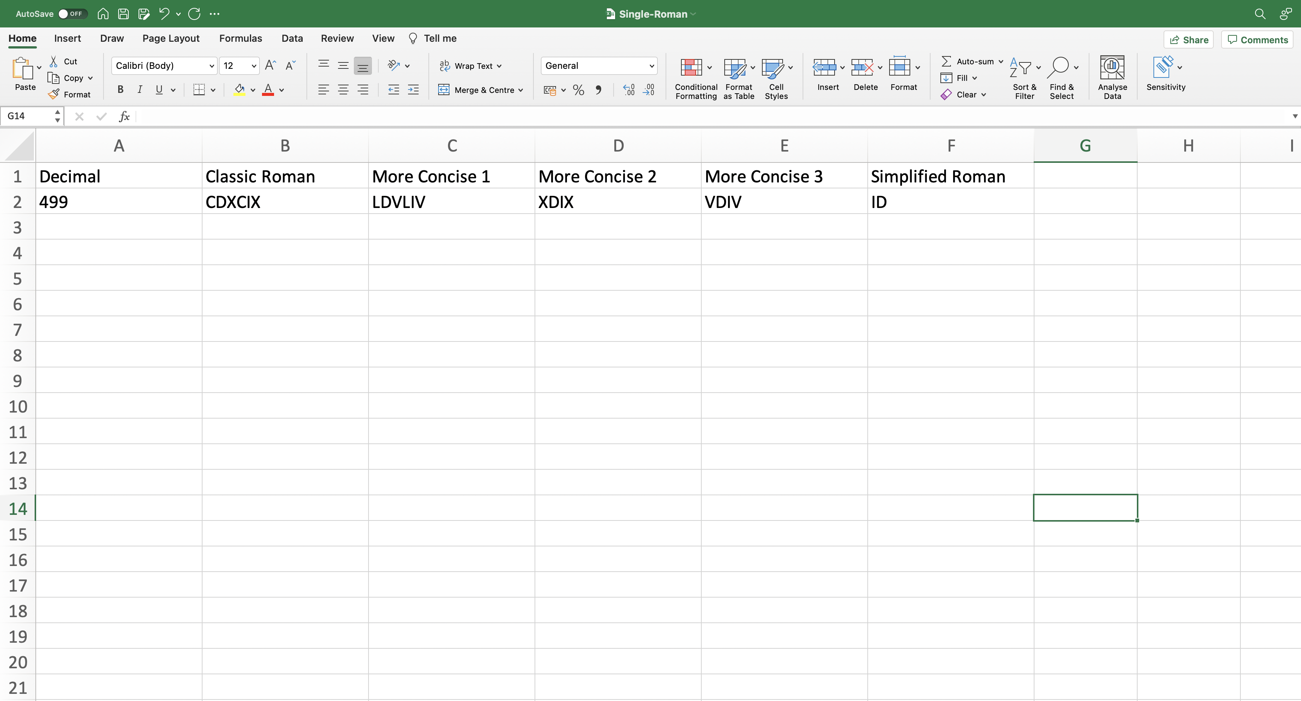

Slide 23
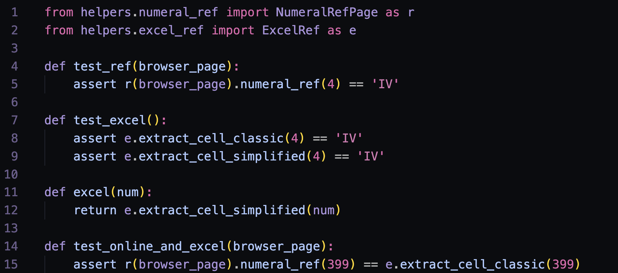
References…
References…

Slide 24
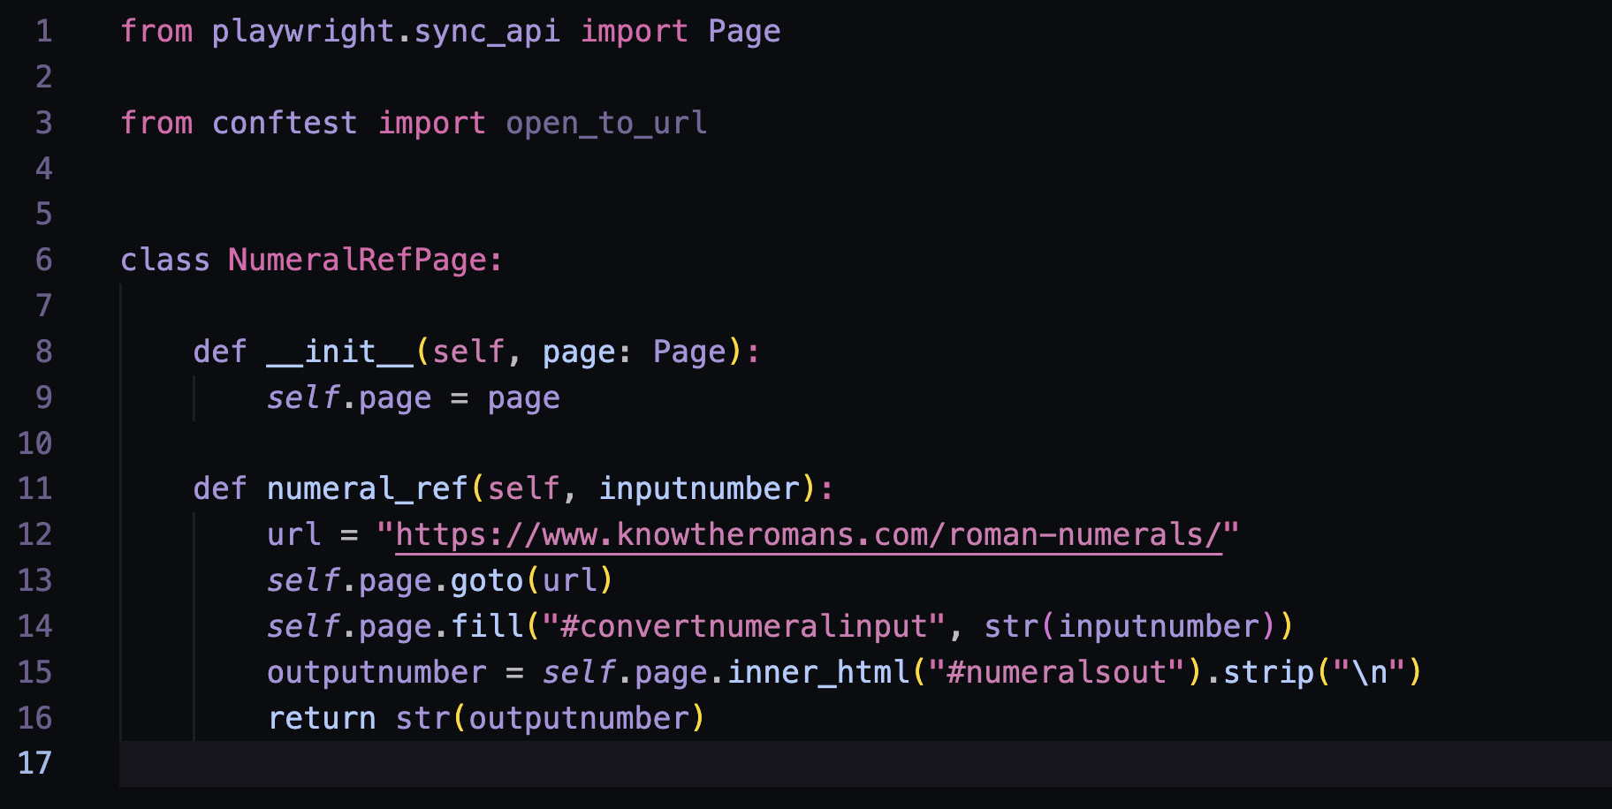
References…

Slide 25
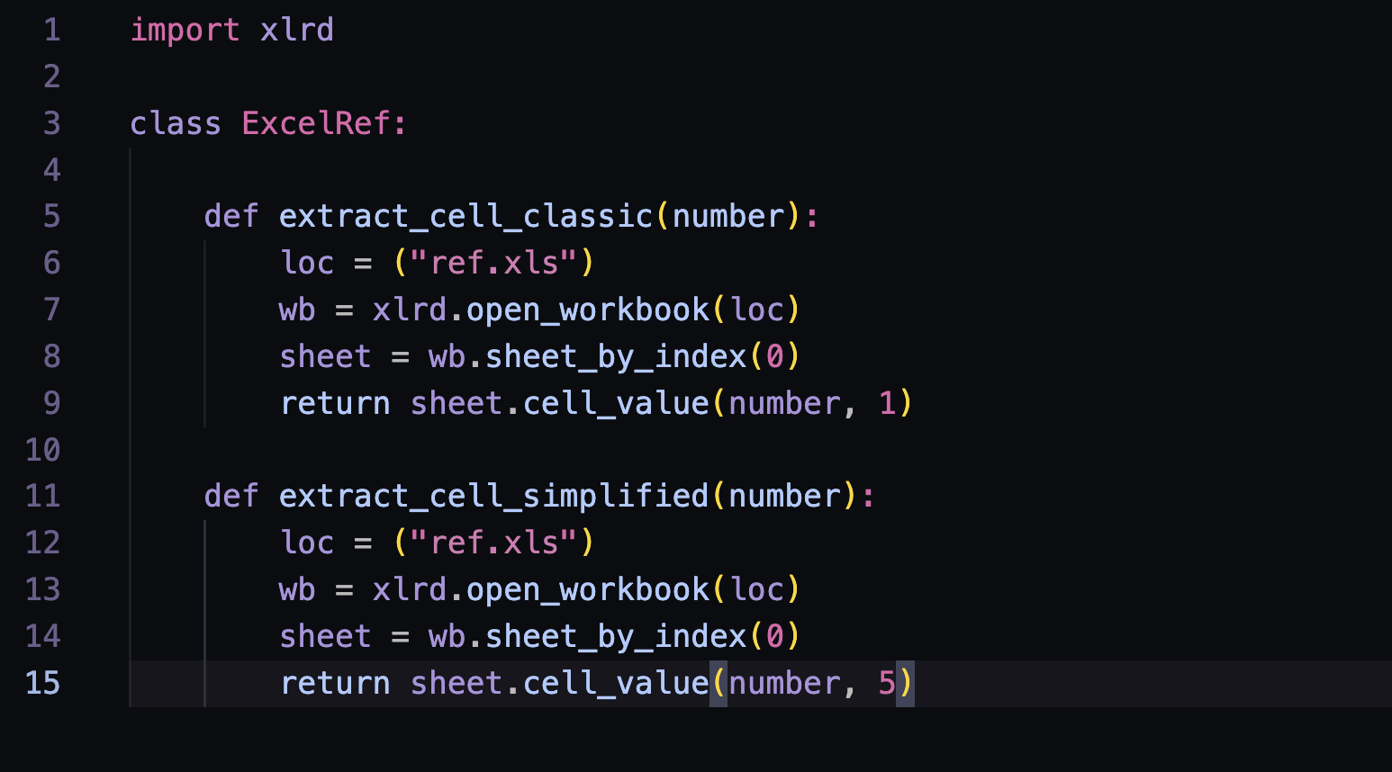
References…

Slide 26
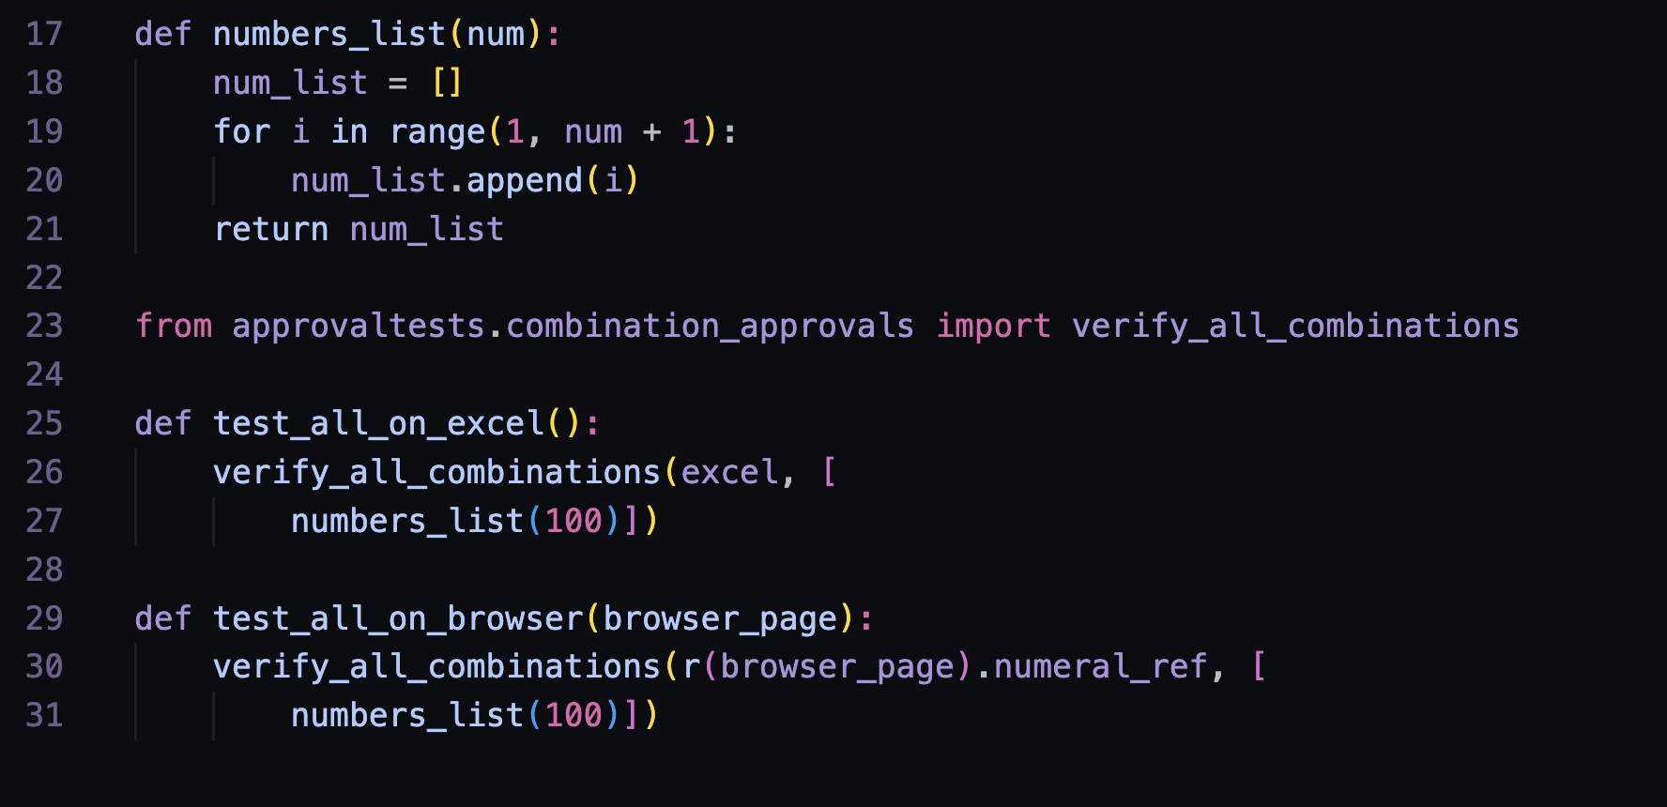
ApprovalTests
Done?

Slide 27
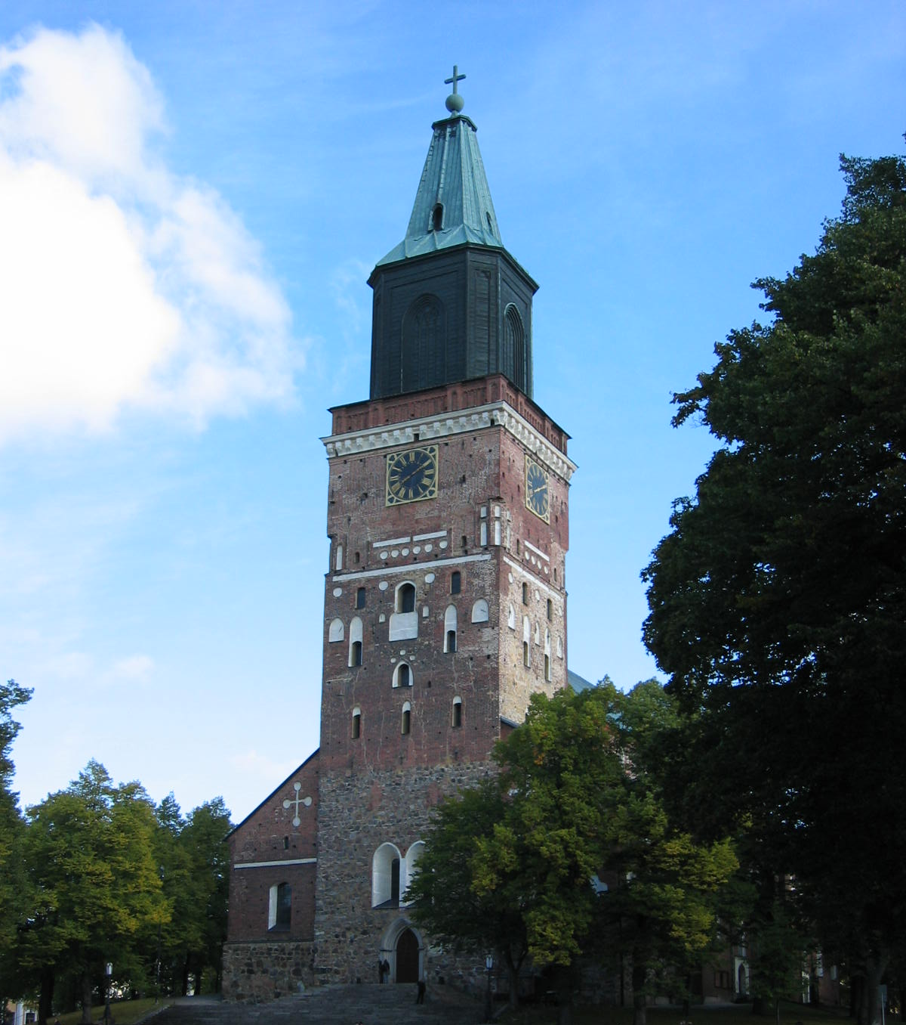
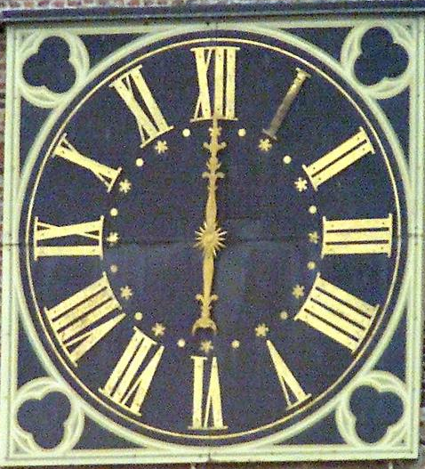
Domain rules: 1V → IIII in clock design as per orders of King Louis XIV of France
https://www.amalgamsab.com/iiii-or-is-it-iv.html
Notes:
Tombstones: 5→ IIIII and 50 -> XXXXX

Slide 28
Note:
…business rules. You think you know them and yet you don’t.

Slide 29
Domain
Part 1. Be the resident expert. Ask around.
Part II. Rules. More rules.
Part III. Find better experts.
Part IIII. Disagreeing with boundaries.
Part IIIII. Oracles.
Part VI. Find better oracles.
Part VII. No user would do what users would do.

Slide 30
Environment
Part 1. Dependencies.
Part II. Interruptions. Both software and hardware.
Part III. People.
“People are not pure functions; they have all sorts of interesting side effects.” - Engineering Management for the Rest of Us, Sarah Drasner
… nor are pure functions if you grow the boundary of what might fail.

Slide 31
1. Intent / Implementation
2. Domain for the Layman
3. Domain for the Expert
4. Reference Implementation
5. People Filtering 6. Interesting side effects
WE are
accountable

Slide 32
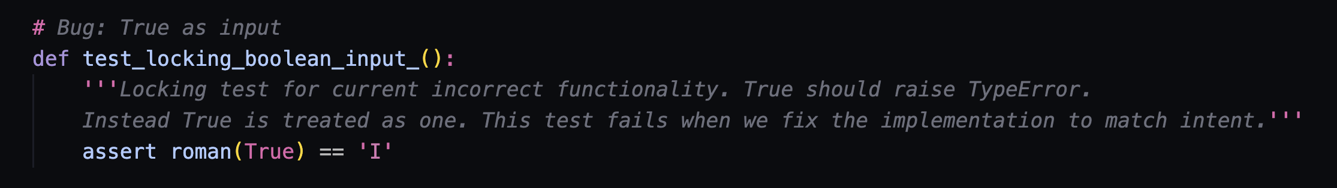
Answer Key to Some of the Bugs
Values over 4k don’t work (without extending to line-on-top notation)
Zeros, fractions, large numbers later in scope
Decimal values truncated vs. rounded
*some of the implementations*
Boundary values miscalculated
Infinite loop
Implementing Classic when expecting Simplified
Someone’s code without license text!

Slide 33
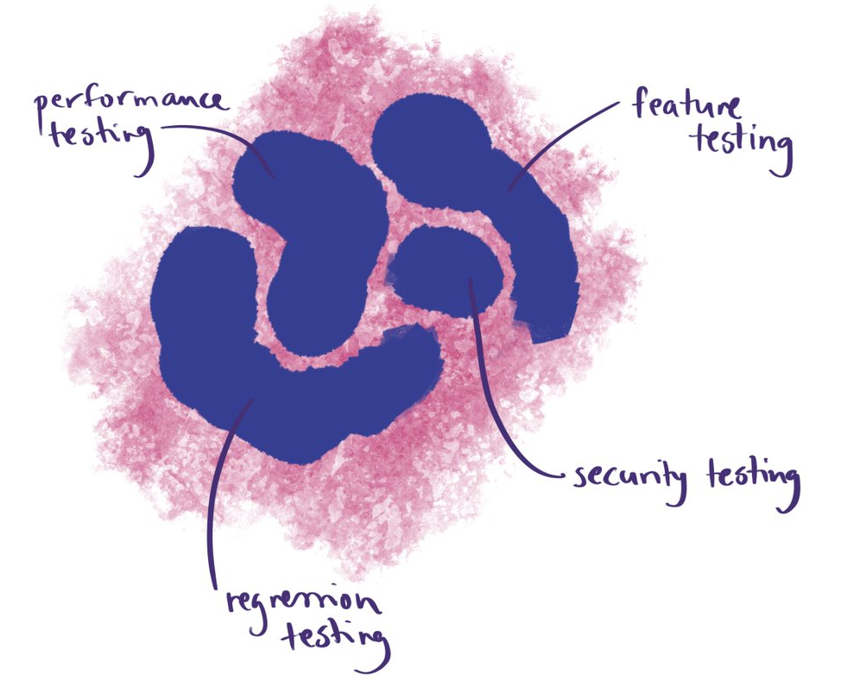
Foo
Contemporary Exploratory Testing

Slide 34
A majority of the production failures (77%) can be reproduced by a unit test.
https://www.usenix.org/system/files/conference/osdi14/osdi14-paper-yuan.pdf
Through https://www.slideshare.net/Kevlin/the-error-of-our-ways

Slide 35
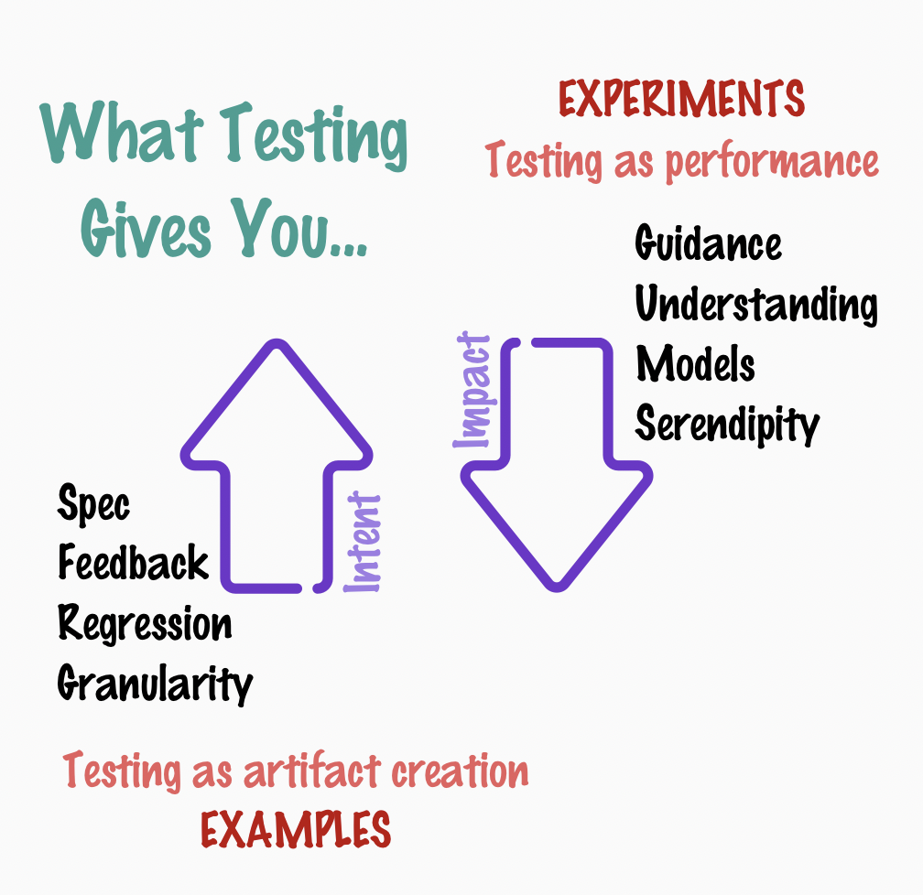
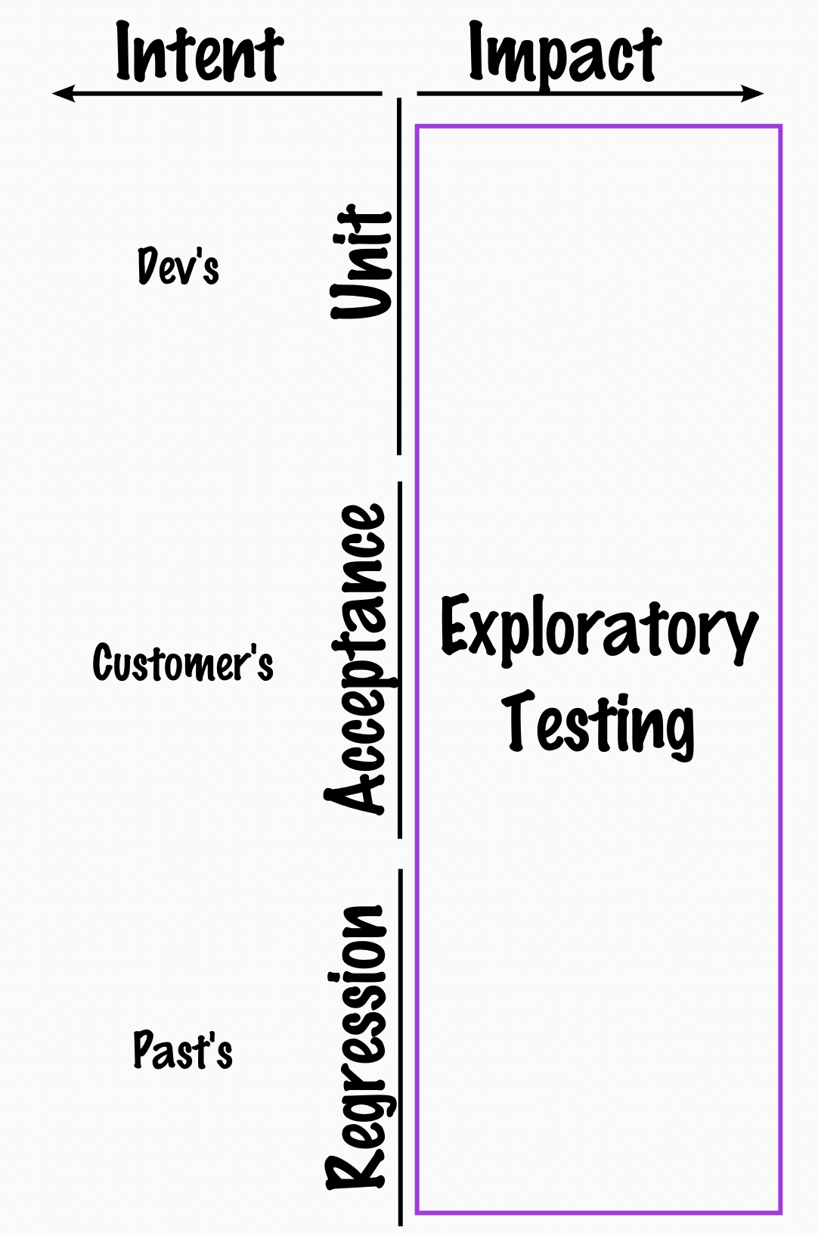
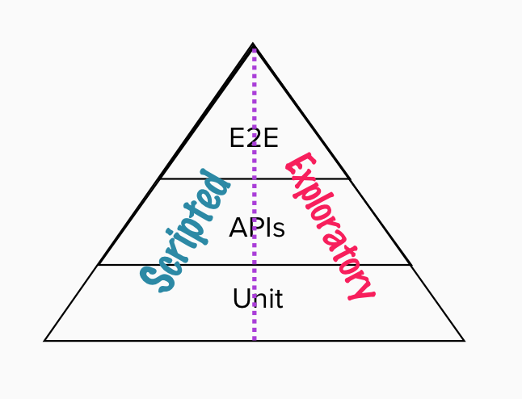

Slide 36
Everything that does not need to be automated gets done while automating.
* Programming with thinking – quality of thinking matters

Slide 37
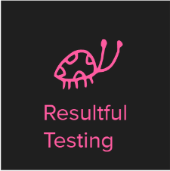
Testing
Find (some of) what others may have missed!
… and never be bored.

Slide 38
Thank You
For pair / ensemble testing this with me <3
Alex, Elisabeth, Bertold, Thomas, Mirja, Karen, Moroni, Isidro, Benjamin & Testing Dozen #1
https://github.com/exploratory-testing-academy/do-a-thing-and-call-it-foo-solution

Slide 39
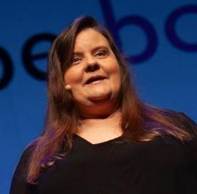






Maaret Pyhäjärvi (from Finland)
https://exploratorytestingacademy.com
MIATPP Most Influential Agile Testing Professional Person
2020
2016
2019 - 2022
Email: maaret@iki.fi
Twitter: @maaretp Web: maaretp.com
Blog: visible-quality.blogspot.fi
(please connect with me through Twitter or LinkedIn)
Ohjelmistotestaus ry
#PayToSpeak #TechVoices #EnsembleTesting #EnsembleProgramming #StrongStylePairing #ExploratoryTesting #TestAutomation
#ModernAgile
#AwesomeTesters
https://techvoices.org

